Slide 1
Welcome!

Slide 2

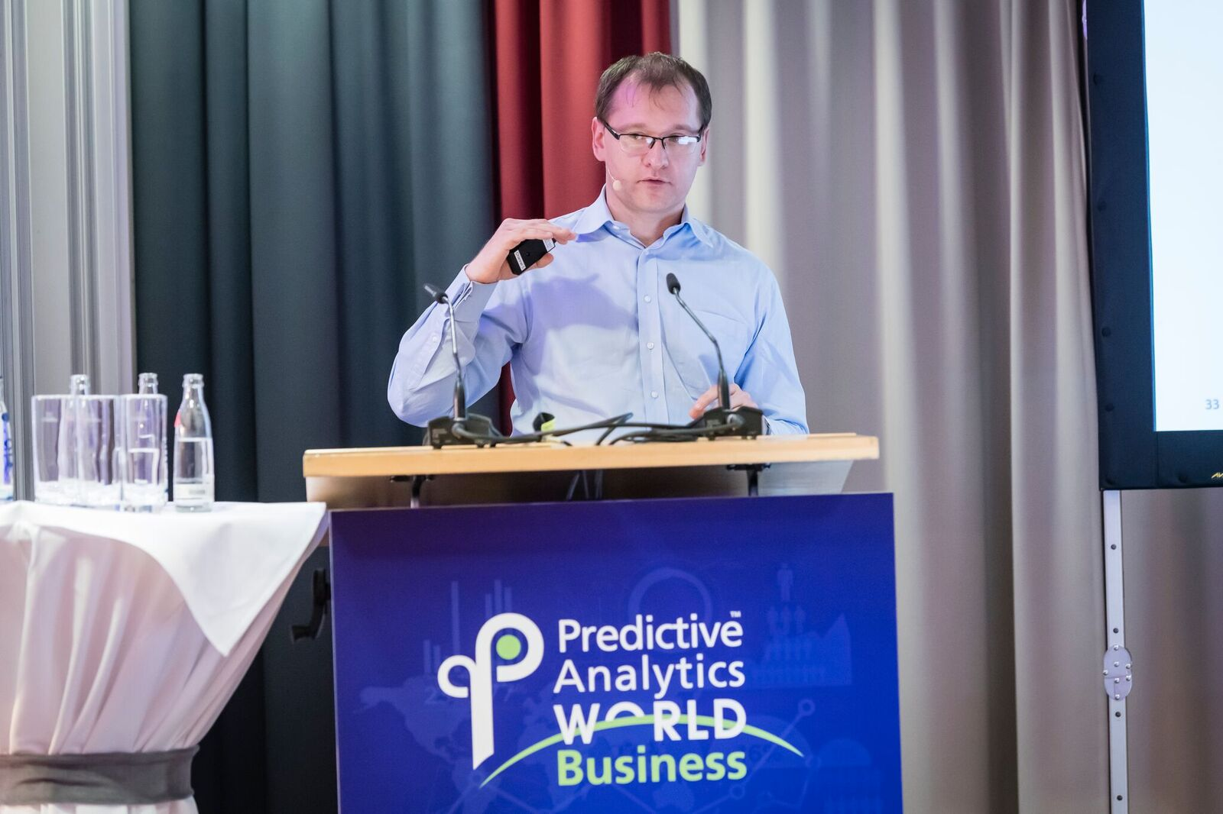
Schwarz group
Company introduction

Slide 3
Rarely discussed topics: explainable AI, fairness, and model attacks

Slide 4
Agenda
01
What is Explainable AI and why we need it.
02
Emerging approaches.
03
Application to retail use cases.
04
Future prospects.
05
Bias and fairness in ML.

Slide 5
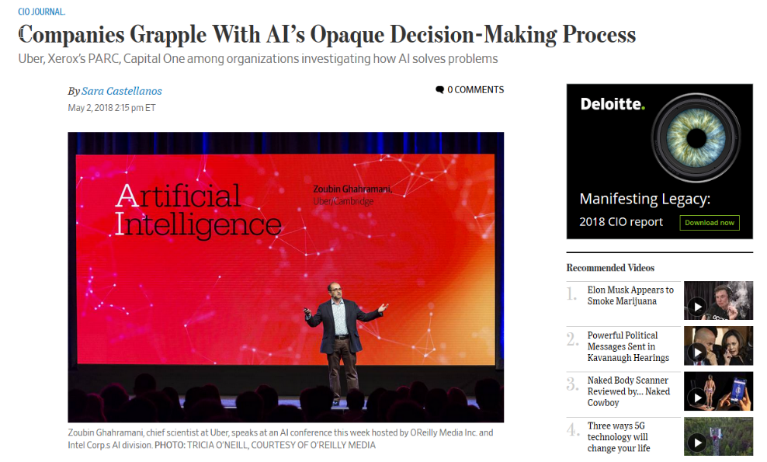
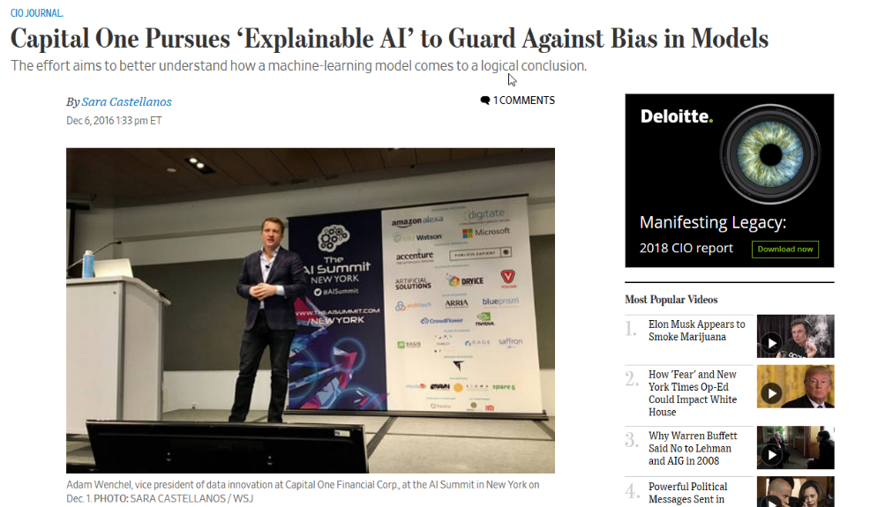
XAI in the media
Introduction

Slide 6
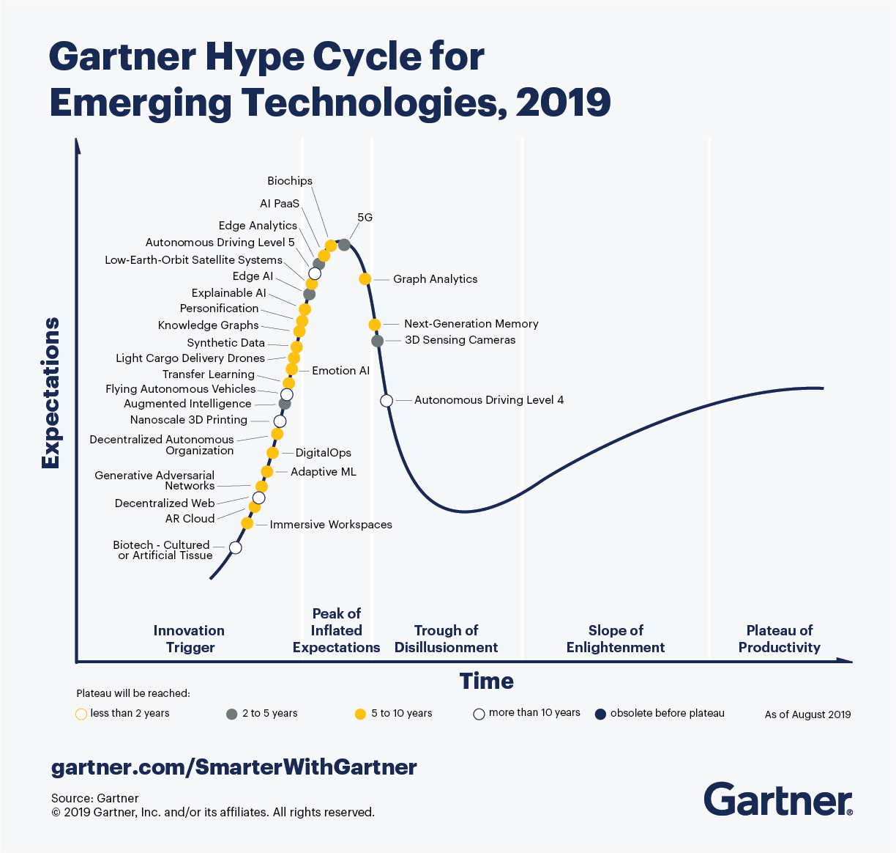
It is a part of hype cycle
Introduction
https://www.gartner.com/smarterwithgartner/5-trends-appear-on-the-gartner-hype-cycle-for-emerging-technologies-2019/

Slide 7
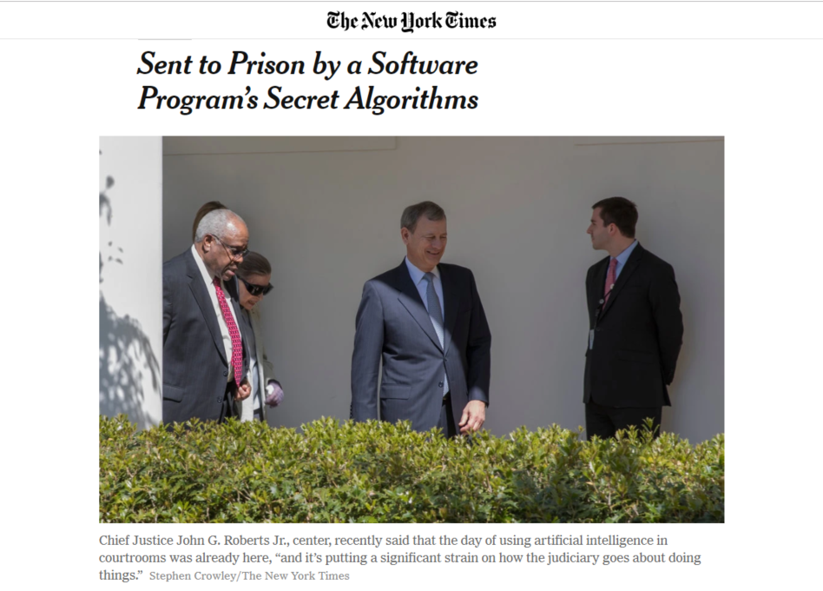
AI application for criminal justise
Introduction
Eric L. Loomis, who was sentenced to six years in prison based in part on a private company’s proprietary software. Mr. Loomis says his right to due process was violated by a judge’s consideration of a report generated by the software’s secret algorithm, one Mr. Loomis was unable to inspect or challenge.
https://www.propublica.org/article/machine-bias-risk-assessments-in-criminal-sentencing

Slide 8
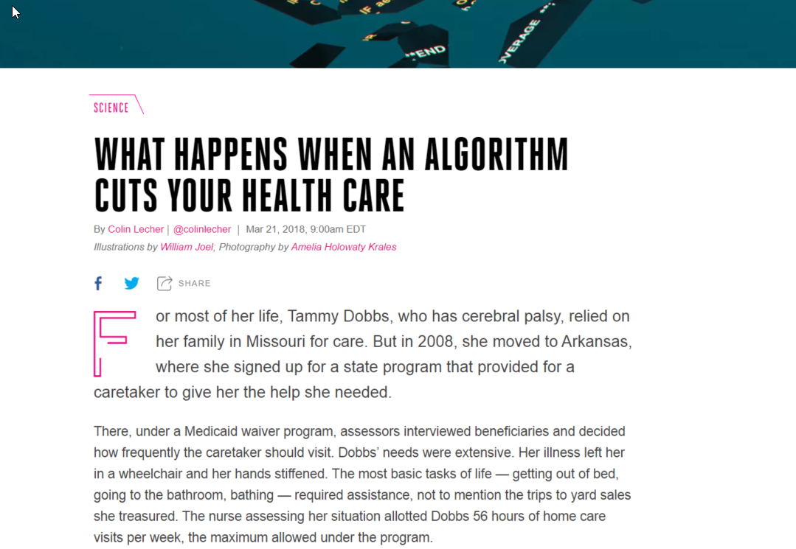
AI application to public spending
Introduction
https://www.theverge.com/2018/3/21/17144260/healthcare-medicaid-algorithm-arkansas-cerebral-palsy

Slide 9
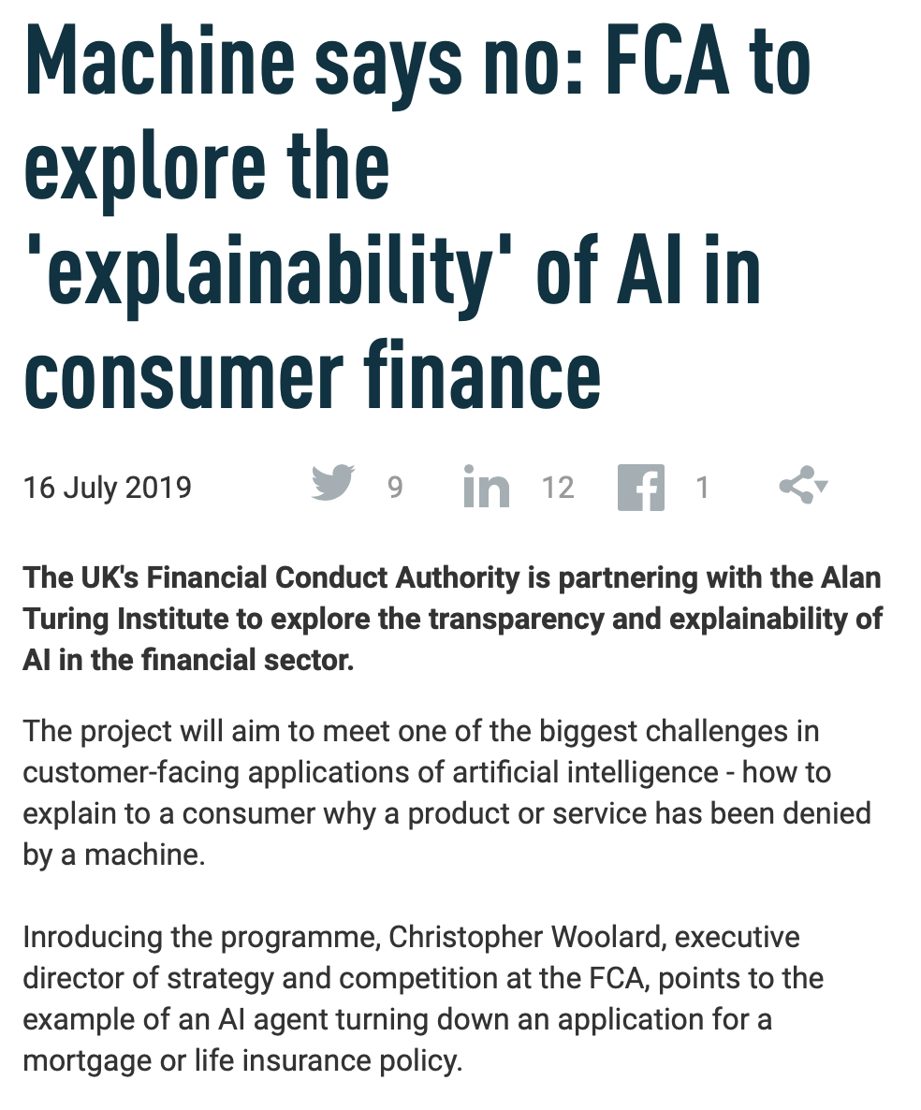
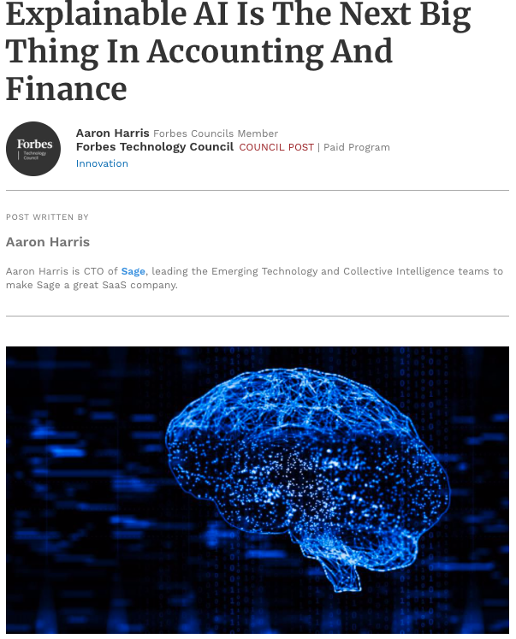
AI application for consumer finance
Introduction

Slide 10
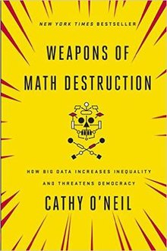
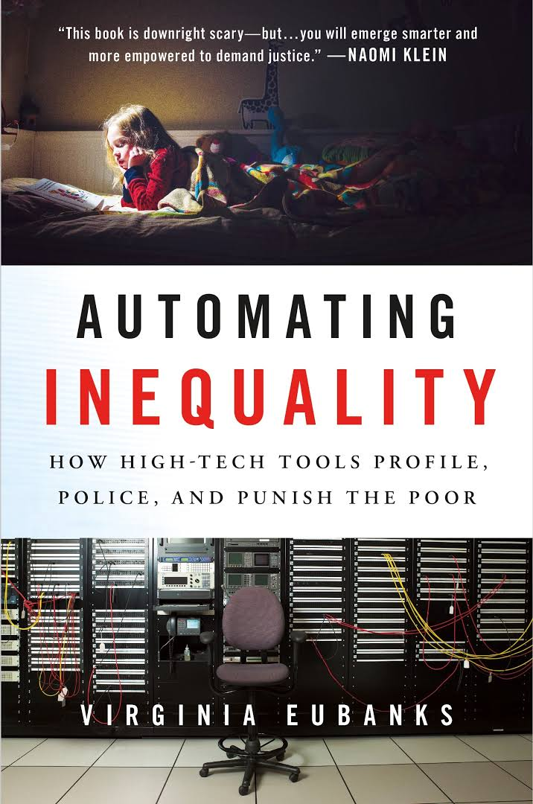
Books
Introduction

Slide 11
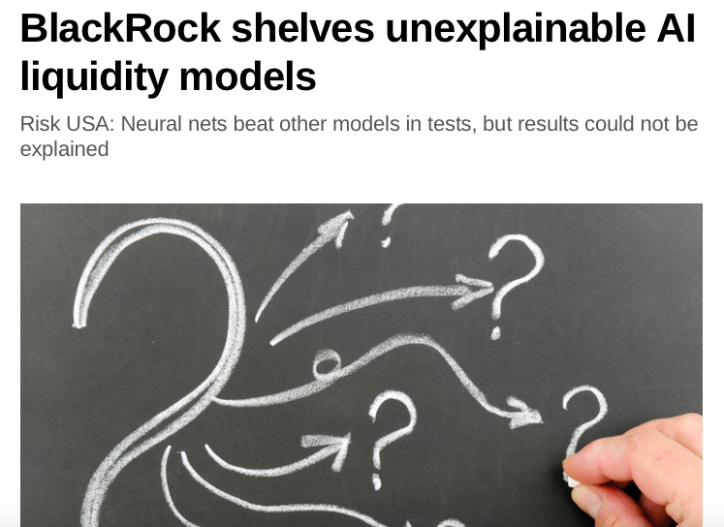
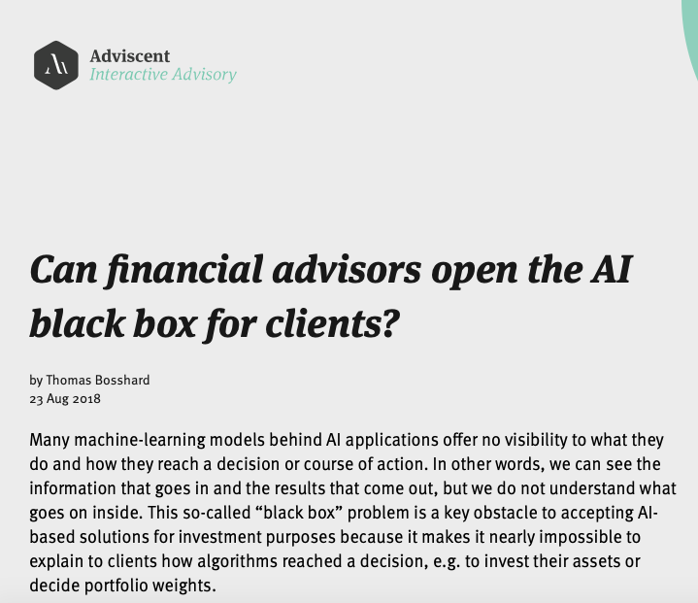
Application in FInance
Introduction

Slide 12
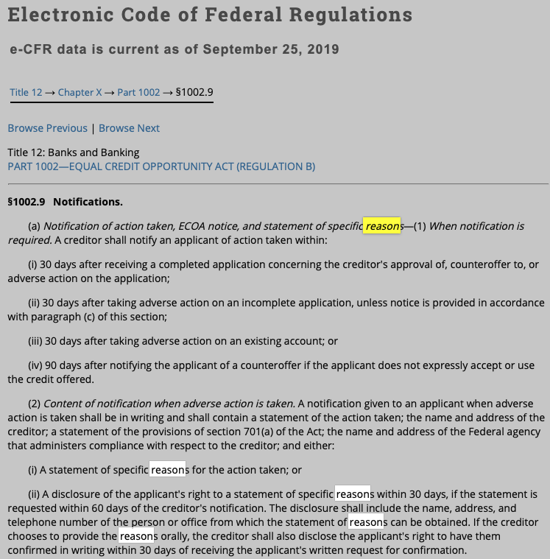
AI Regulation for finance (USA)
Introduction
Statement of specific reasons. The statement of reasons for adverse action required by paragraph (a)(2)(i) of this section must be specific and indicate the principal reason(s) for the adverse action. Statements that the adverse action was based on the creditor's internal standards or policies or that the applicant, joint applicant, or similar party failed to achieve a qualifying score on the creditor's credit scoring system are insufficient.

Slide 13
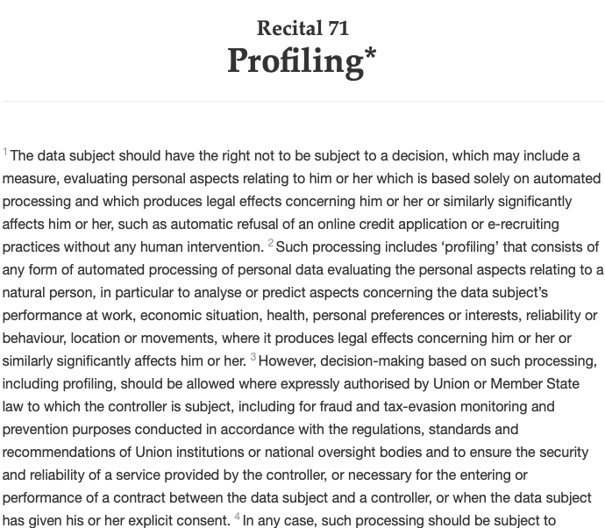
AI Regulation for finance (EU)
Introduction
The data subject should have the right not to be subject to a decision, which may include a measure, evaluating personal aspects relating to him or her which is based solely on automated processing and which produces legal effects concerning him or her or similarly significantly affects him or her, such as automatic refusal of an online credit application or e-recruiting practices without any human intervention.

Slide 14
What is XAI?
Introduction
Explainable AI
XAI aims to produce "glass box" models that are explainable to a "human-in-the-loop", without greatly sacrificing AI performance.
Human users should be able to understand the AI's cognition (both in real-time and after the fact), and should be able to determine when to trust the AI and when the AI should be distrusted

Slide 15
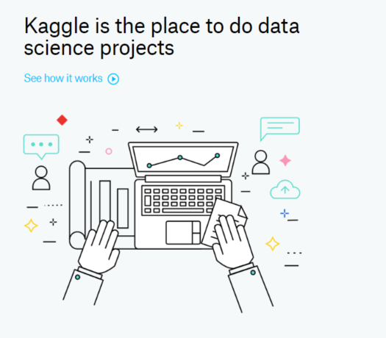
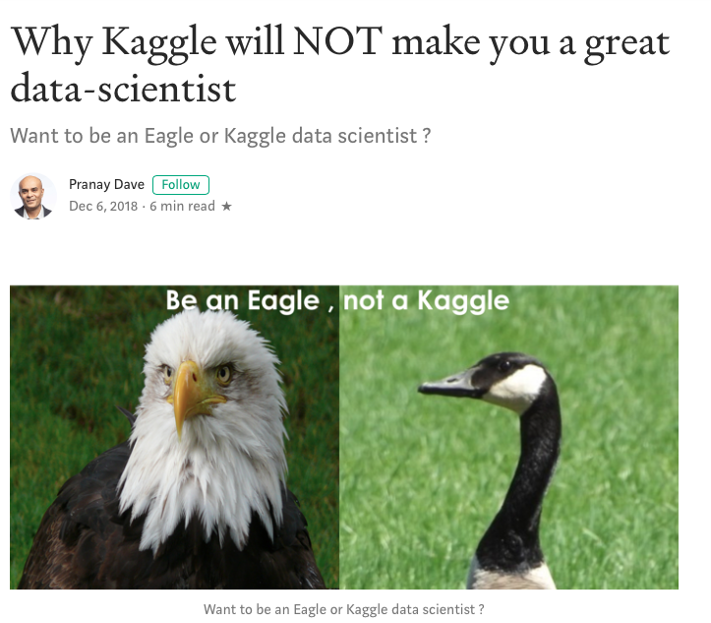
All attention was here
Introduction
AI competitions don’t produce useful models
https://lukeoakdenrayner.wordpress.com/2019/09/19/ai-competitions-dont-produce-useful-models/

Slide 16
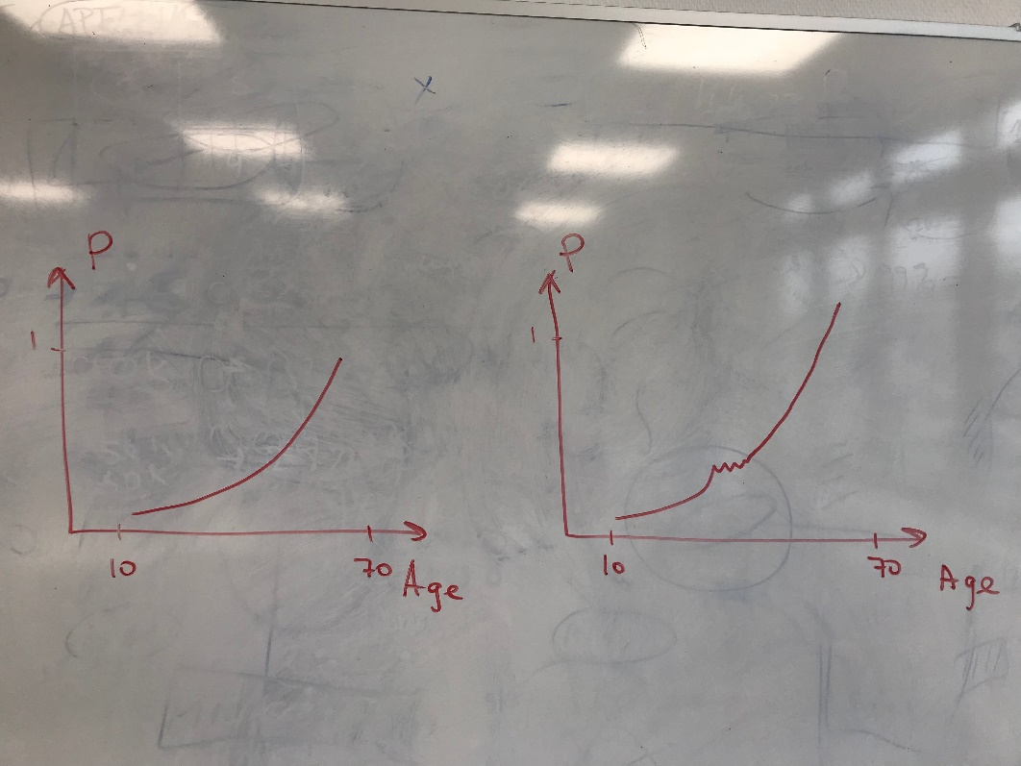
What can happen
Introduction
Two models.
One with feature set A
The other one with an extended featue set

Slide 17
What data scientists get wrong about XAI
Introduction
01
Judge AI as alternatives rather than aides
“Considering machine learning systems as a replacement for a human makes it is easier to assume that no detailed explanation is needed so long as they do their job. However, most AIs will be aides that augment human decision making and clearly need to explain their results.”
02
Expect stakeholders to “think more like me”
03
Optimize for model performance over enterprise utility
04
Value XAI only as a placebo
05
Believe what is said is what will be heard

Slide 18
What data scientists get wrong about XAI
Introduction
01
Judge AI as alternatives rather than aides
“Machine learning practitioners must adapt our systems to fit the expectations of the world, rather than expect the world to adapt to our expectations.”
02
Expect stakeholders to “think more like me”
03
Optimize for model performance over enterprise utility
04
Value XAI only as a placebo
05
Believe what is said is what will be heard

Slide 19
What data scientists get wrong about XAI
Introduction
01
Judge AI as alternatives rather than aides
“It’s natural for data scientist to see everything as an optimization problem. The trick is knowing what to optimize for. It is tempting to work at the lab bench focused on optimizing your model as measured by the typical machine learning metrics. What is harder to do but far more valuable is to optimize for the benefits and overall utility of the encompassing system.”
02
Expect stakeholders to “think more like me”
03
Optimize for model performance over enterprise utility
04
Value XAI only as a placebo
05
Believe what is said is what will be heard

Slide 20
What data scientists get wrong about XAI
Introduction
01
Judge AI as alternatives rather than aides
“It is easy to imagine the only benefit of explainability is to placate the users. That is a tempting idea, it is also wrong.”
02
Expect stakeholders to “think more like me”
03
Optimize for model performance over enterprise utility
04
Value XAI only as a placebo
05
Believe what is said is what will be heard

Slide 21
What data scientists get wrong about XAI
Introduction
01
Judge AI as alternatives rather than aides
“It is common to have a disconnect between what a machine learning model is actually communicating vs. what the stakeholders are hearing. Users can extrapolate the recognition of a pattern into unwarranted confidence in a presumed course of action.”
02
Expect stakeholders to “think more like me”
03
Optimize for model performance over enterprise utility
04
Value XAI only as a placebo
05
Believe what is said is what will be heard

Slide 22
What data scientists get wrong about XAI
Introduction
06
Provide a single explanation for all audiences
“Data scientists tend to think in terms of rigorous
ideals. They like clear cut goals and provably correct answers. So it is natural to think that a given model or a specific result has a single definitive explanation. But of course they don’t, different audiences need different explanations.”
07
Undervalue explanation friendly features
08
Fail to design for debugging
09
Assume rather than demonstrate generalizability
10
Think moonshots are the model

Slide 23
What data scientists get wrong about XAI
Introduction
06
Provide a single explanation for all audiences
“Model features shouldn’t be judged just on statistical equivalence, run time speed and server resource use. They should also be judged based whether they clarify the connection between our model and reality. They should be judged based on how much they contribute to explanations
and generalizability.”
07
Undervalue explanation friendly features
08
Fail to design for debugging
09
Assume rather than demonstrate generalizability
10
Think moonshots are the model

Slide 24
What data scientists get wrong about XAI
Introduction
06
Provide a single explanation for all audiences
“Every system will have failures in production. Robust systems design in from the start the mechanisms needed to quickly isolate and resolve those failures. For example, if we make it easier to distinguish expected outliers from true errors we will accelerate troubleshooting.”
07
Undervalue explanation friendly features
08
Fail to design for debugging
09
Assume rather than demonstrate generalizability
10
Think moonshots are the model

Slide 25
What data scientists get wrong about XAI
Introduction
06
Provide a single explanation for all audiences
“We tend to be overly optimistic about our models ability to generalize. Models that work well on the lab bench and in initial production use may still have latent limitations on their ability to succeed over time, geography and use case. XAI approaches can reveal latent issues and allow non-data scientists to build confidence in how broadly a model can be applied.”
07
Undervalue explanation friendly features
08
Fail to design for debugging
09
Assume rather than demonstrate generalizability
10
Think moonshots are the model

Slide 26
What data scientists get wrong about XAI
Introduction
06
Provide a single explanation for all audiences
“When we think of AI what comes to mind first are the moonshots: the decade long projects that use
breakthrough new technology to implement radical solutions to huge problems. However, consider the distribution of all machine learning projects over the next decade, only a tiny sliver of them will be these ultra expensive ground breaking projects. We need to design our common toolsets and methodologies for the median machine learning project not the moonshots.”
07
Undervalue explanation friendly features
08
Fail to design for debugging
09
Assume rather than demonstrate generalizability
10
Think moonshots are the model

Slide 27
Why we need XAI?
Introduction
01
Safety. We should build systems that make sound decisions.
02
Debugging. We should understand why a system does not work and how to fix it.
03
Science. We want to understand something new.
04
Mismatched Objectives. The system may not be optimized for the true objective.
05
Legal. Are we legally required to provided an explanation?

Slide 28
Emerging and existing approaches for tabular data
Emerging approaches
XAI
Glass-box models
Model explanation (global)
Post-hoc model explanations (local)
Linear regression
Logistic regression
Decision trees
Rule list
Rule sets
GAM
Etc.
Visualisation
Agnostic feature importance
Model surrogates
Local surrogate (LIME)
Local feature attribution (SHAP)
Local rule extraction (Anchor, LORE)
Contrastive explanations
Counterfactual explanations

Slide 29
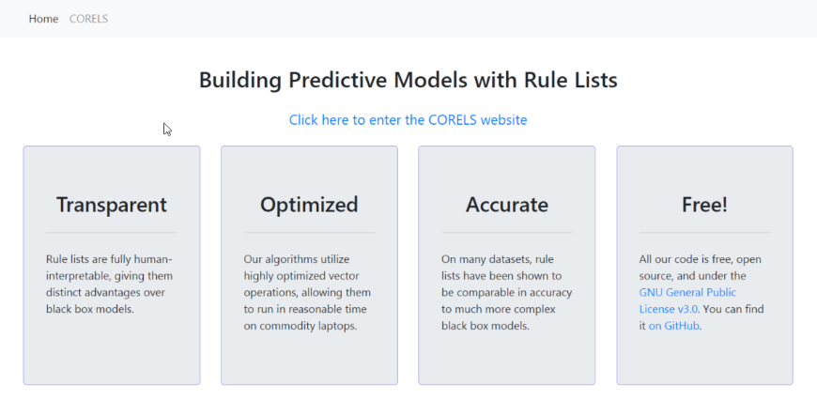
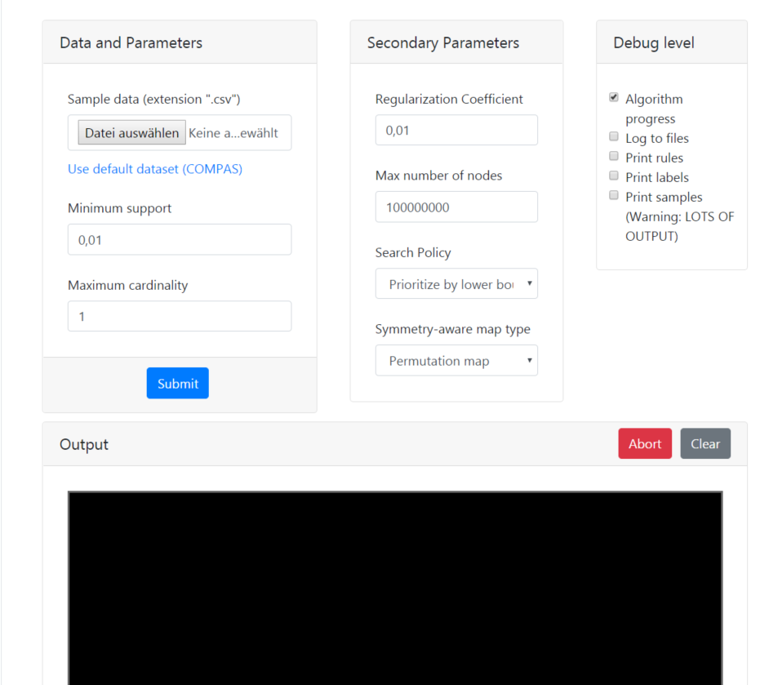
Try CORELS
https://corels.eecs.harvard.edu/corels/run.html

Slide 30
Emerging and existing approaches for tabular data
Emerging approaches
XAI
Glass-box models
Model explanation (global)
Post-hoc model explanations (local)
Linear regression
Logistic regression
Decision trees
Rule list
Rule sets
GAM
Etc.
Visualisation
Agnostic feature importance
Model surrogates
Local surrogate (LIME)
Local feature attribution (SHAP)
Local rule extraction (Anchor, LORE)
Contrastive explanations
Counterfactual explanations

Slide 31
XAI in retail
Application to retail
XAI
Stakefolder management
Build user trust
Model debugging

Slide 32
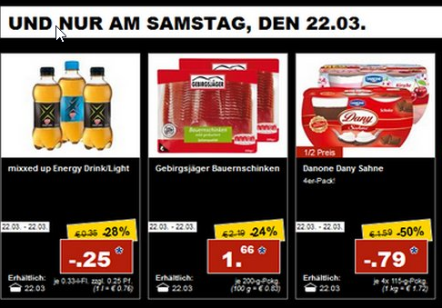

Consider a problem of promotion planning
Application in retail
Planners collect data on their own
Planners have to decide
what,
when,
under what conditions
How much
Experience generates rules

Slide 33
Consider a problem of promotion planning
Application in retail
AI
Counterintuitive results generate mistrust.
Users stop using and rely more on personal intuition.
Experience generates rules

Slide 34
Consider a problem of promotion planning
Application in retail
AI
1.80 < abs_price_diff < 3.11 AND 327.75 < avg_regular_sales < 662.83
expiration_days = 6 AND sale_length_clean = 3 AND 4689.8 < total_regular_revenue < 11219.6
OR
The model predicted 5.48 instead of more than 5.48 because abs_price_diff <= 1.796 and year > 2015
The model predicted 4.54 instead of more than 4.54 because total_regular_revenue > 6129.841 and sale_length > 6.463
Experience generates rules

Slide 35
Consider a problem of promotion planning
Application in retail
Original problem
Regression
Classification
Predict sales during promotions
Predict if sales uplift is greater or less than a median

Slide 36
EXAMPLE
Application in retail
We have to plan a new promotion and would like to see how effective it will be and Why.

Slide 37
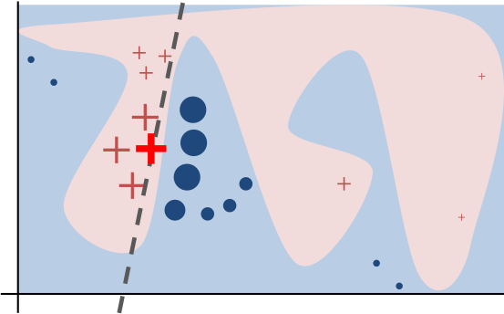
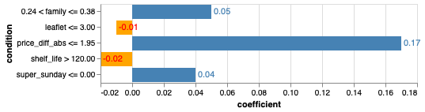
LIME
Emerging approaches
LIME is a local surrogate model
We pick some promotion to classify
The promotion was classified as being over the median
With score 0.96

Slide 38
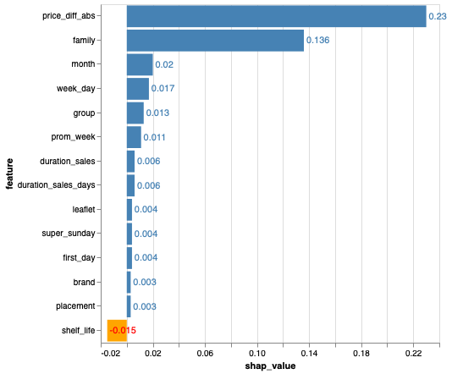
SHAP
Emerging approaches
SHAP value explains the contribution to explain the difference between the average model prediction and the actual prediction of the instance.

Slide 39
Anchor
Emerging approaches
Anchor – local rules with guarantees
price_diff_abs <= 2.00 AND family <= 0.38 AND placement > 0.00

Slide 40
Counterfactual explanations
Emerging approaches
What minimal changes do we need to introduce to flip the prediction
One can only allow changes to specific features (month, day, store location, etc.)
Sometimes it is not possible to find a counterfactual, especially when model score is close to 1.
A counterfactual:
family: change item family
group: change item group
price_diff_abs: decrease price by 2

Slide 41
Contrastive explanations
Emerging approaches
„Why P rather than Q?“
The model predicted '0' instead of '1' because 'price_diff_abs <= 2.934

Slide 42
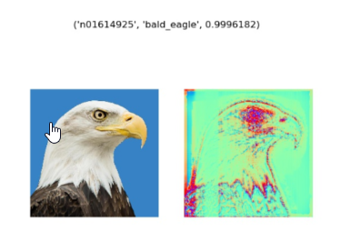
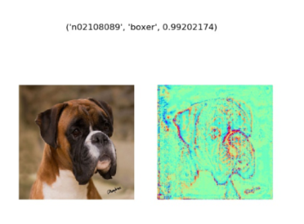
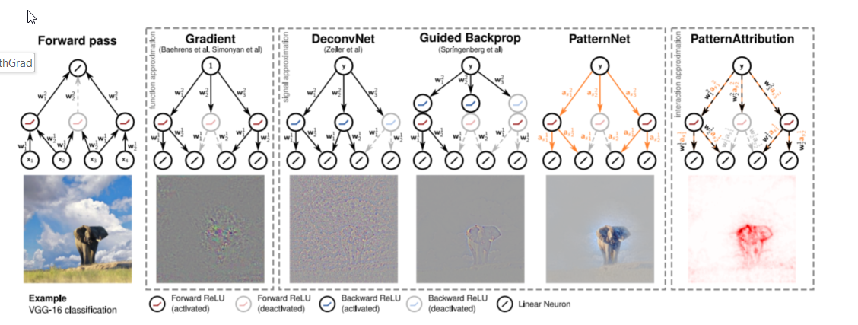
Xai for nlp and computer vision
Future prospects
Saliency maps
Layer-wise Relevance Propagation
Gradient based methods
TCAV
Etc.

Slide 43
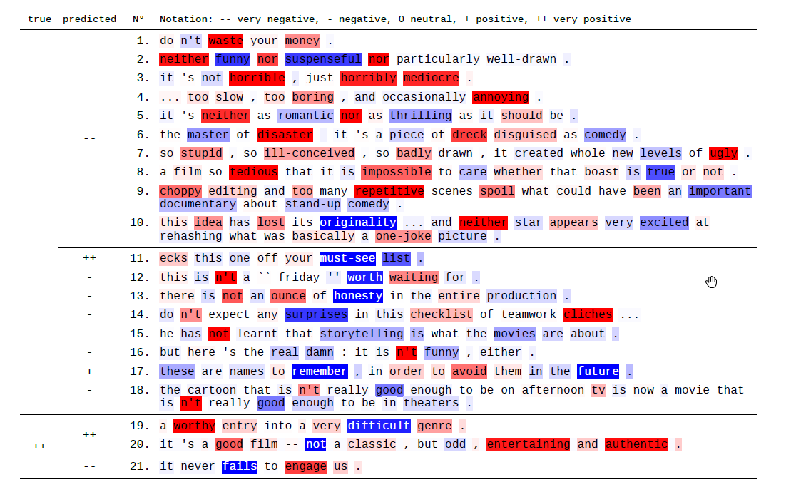
Xai for nlp and computer vision
Future prospects
Layer-wise Relevance Propagation (LRP)
Learning to explain (L2X)
SHAP
LIME
Etc.

Slide 44
Bias in Machine learning

Slide 45
Types of Bias
Algorithmic fairness
Simpson paradox
Representation bias (ImageNet)
BIAS
Sampling bias
Measurement bias
(proxy)
Algorithmic bias
Aggregation bias
(general assumptions)

Slide 46
Definitions of fairness
Algorithmic fairness
Equalized odds
Treatment equality
Equalized opportunity
Test fairness
Fairness
Demographic parity
Counterfactual fairness
Fairness through awareness
Fairness in Relational Domains
Fairness through unawareness
Conditional Statistical Parity

Slide 47
Methods for fair ML
Algorithmic fairness
Fair classification
Fair regression
Fair ML
AdaFair
FairCORELS
Fairness Aware DT (FAHT)
Regularization approahes
Fair quantile regression
Regression with fairness penalties
Data preprocessing
Fair NLP
Relabelling
Reweighting
Sampling
Fair word embeddings

Slide 48
Tools
Algorithmic fairness
Aequitas
Themis ML
Tools
AIF360
FAT Forensics

Slide 49
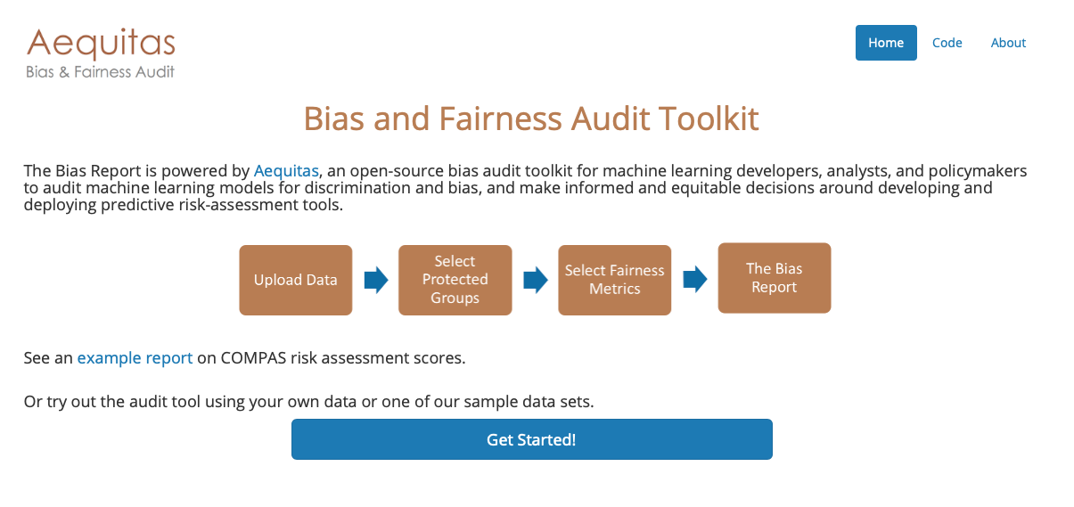
Tools
Algorithmic fairness http://aequitas.dssg.io

Slide 50
Attacks on machine learning

Slide 51
JOIN the club
Collaborate
https://www.linkedin.com/groups/8672810/ - my LinkedIn group Explainable AI –XAI
https://github.com/andreysharapov/xaience - resources on XAI, fairness and more
https://www.xaience.eu/ - my webpage with services

Slide 52
I invite everyboby to collaborate in the field of explainable AI and algorithmic fairness
Thank you for the time you spend with me

